Slide 1
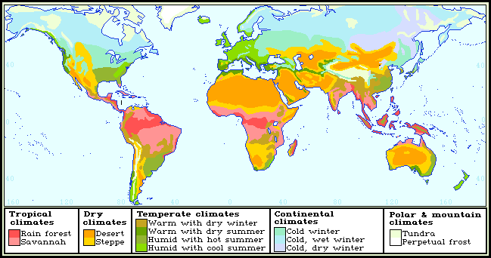
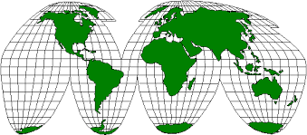
Maps
Maps are drawings that show regions on flat surfaces. Maps are easier to use and carry than globes, but they cannot show the correct size and shape of every feature on Earth’s curved surface. For this reason Cartographers (Map Makers) have created many different types of maps.

Slide 2
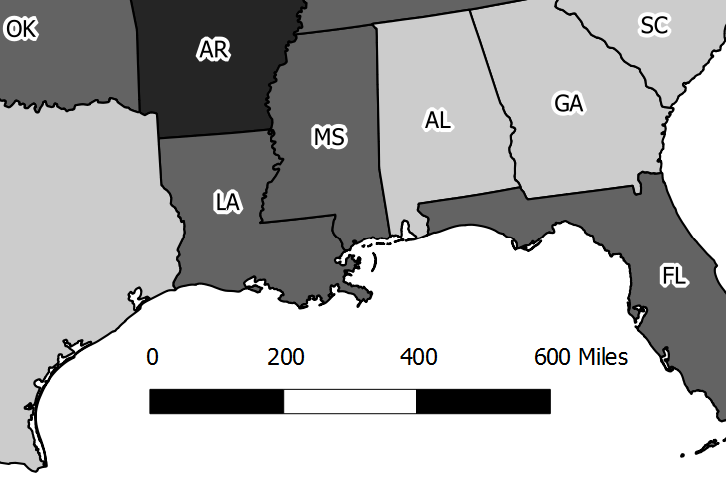
Clues To Help You Understand A Map
Map Scale or Scale Bar
The Map Scale or Scale Bar helps you determine the distances between places on a map.
EXAMPLE

Slide 3
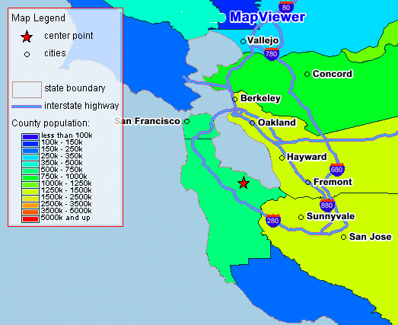
Map Key or Map Legend
The Map Key or Map Legend is used to explain the lines, colors, and other symbols on the map.

Slide 4
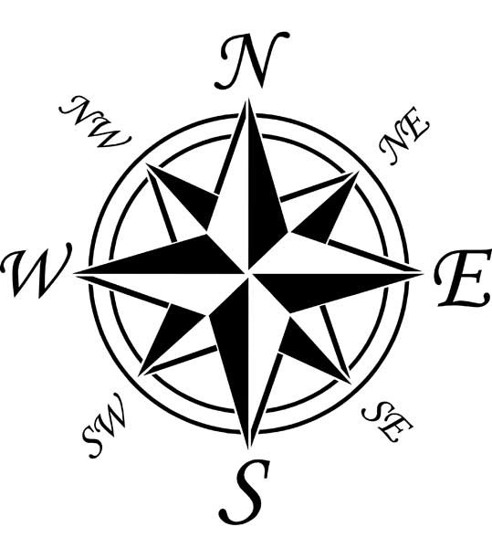
Compass Rose
The compass rose is a design on charts or maps that shows directions such as North & South

Slide 5
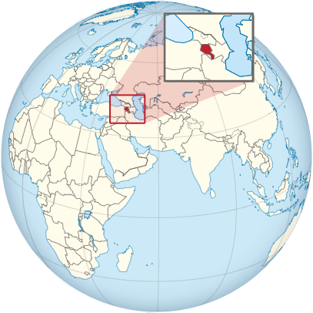
Locator Globe
The locator globe shows where on the globe the area of the map is located

Slide 6
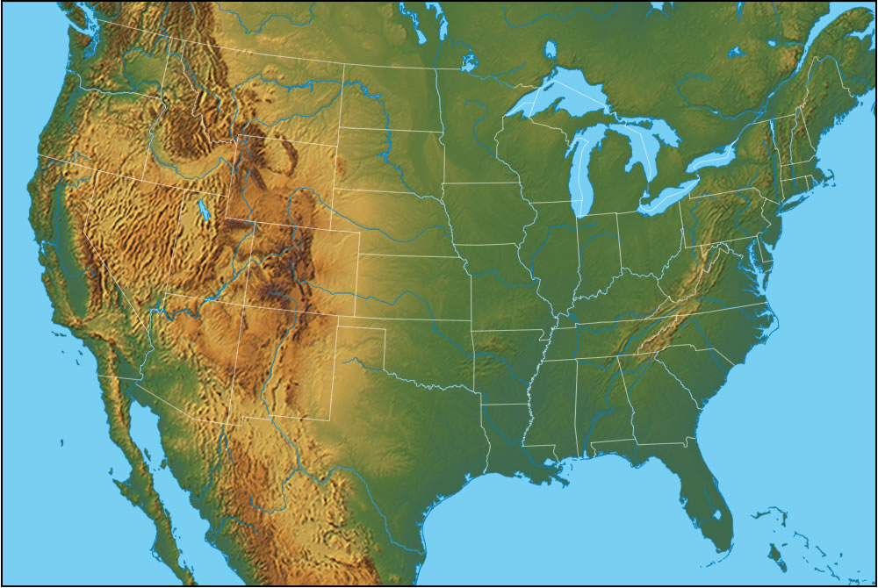
A map that shows what the surface of the Earth looks like. Examples would be landforms and bodies of water. All things of nature.
Two Types of Maps
Physical Maps

Slide 7
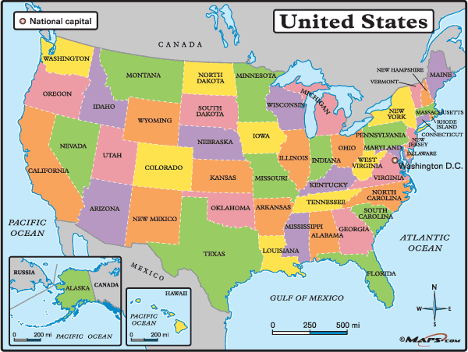
A map that shows how people have divided the Earth into countries, states, cities, and other units for the purpose of governing.
Political Maps

Slide 8
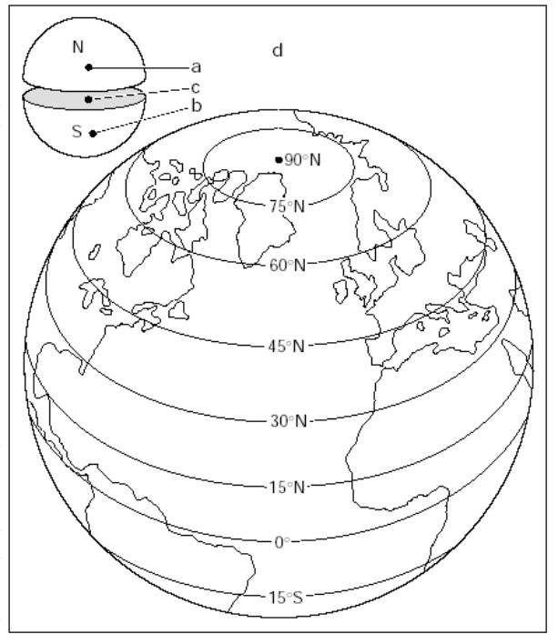
Latitude Lines
Other Important Geography terms
Imaginary lines that measure distance from the equator. Lines of latitude run from east to west, but measure north and south

Slide 9
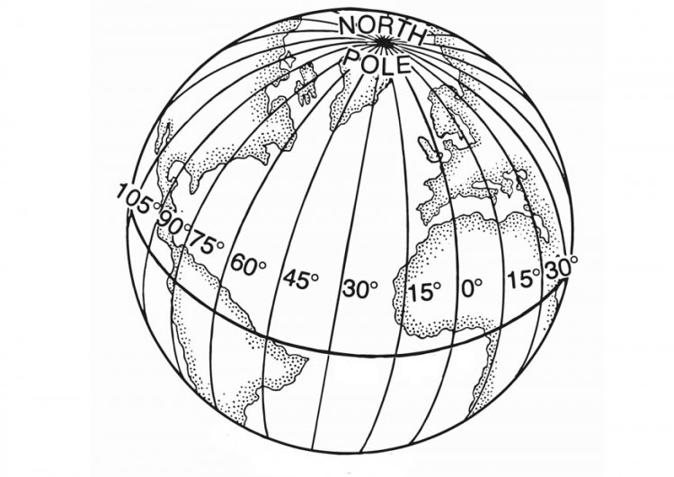
Longitude Lines
Imaginary lines that measure distance from the Prime Meridian. Lines of longitude run from north to south, but measure east to west

Slide 10
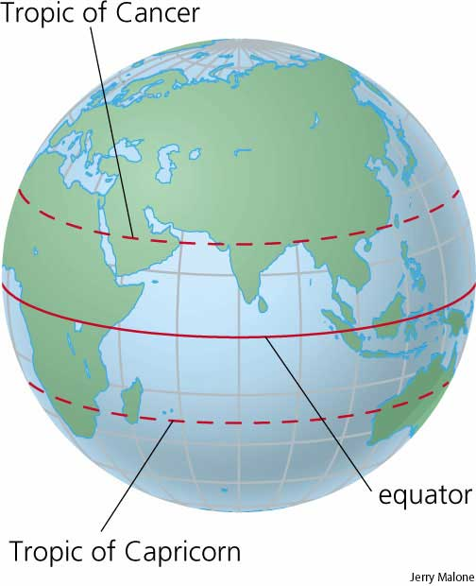
Equator
An imaginary circle around the Earth that is everywhere equally distant from the two poles. The Equator is a line of latitude.

Slide 11
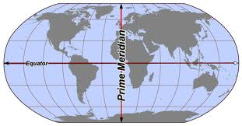
Prime Meridian
An imaginary line that passes through Greenwich, England. Divides the Earth into Eastern and Western hemisphere

Slide 12
More Important Terms
Elevation: The height of land above sea level
Sea Level: The average height of the oceans surface
Relief: Shows how quickly the land rises and falls
Climate: Average weather condition of a place overtime

Slide 13
More Important Terms
Migration: The movement of humans from one place to another
Commercial Farming: Production of crops for profit and sale
Subsistence Farming: Production of crops primarily for consumption

